Slide 1
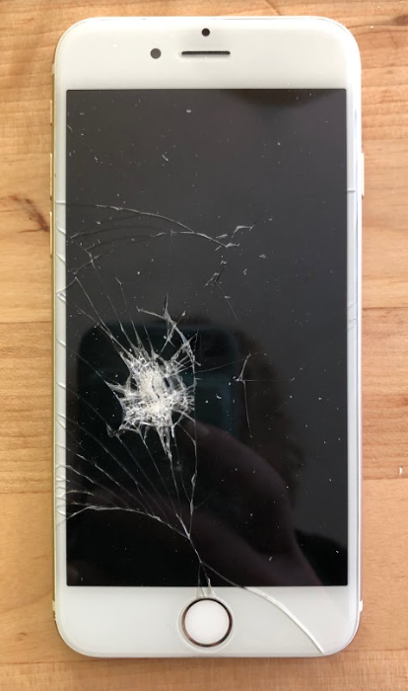
Slide A
Revisiting Our Phenomenon
Cell Phone Damage
Americans break 2 smartphone screens every second.
More than 50 million phone screens are cracked each year.
An estimated 95 million phones were damaged in the world by dropping them.
We spend $3.4 BILLION each year in replacing cracked screens--not counting the 38% of smartphone owners who don’t replace them at all.
27% of people said that their phone was in a case when they broke it.
Source- Miami Herald
Notes:
Recall anchoring phenomenon. Project slide A. Say, When we started this unit, we looked at some interesting data. I was looking at it again and one piece of data stuck out. We’ve learned about and explained how different objects can get damaged in a collision, but even when some objects are protected sometimes they still get damaged. Look at these data from our original phenomenon.
Read the data from slide A. Point out the datum regarding phones breaking while still in their cases.
27% of people said that their phone was in a case when they broke it.
Say, Even with cases, 27% of the phones were still getting broken! So the cases do not completely prevent damage.
Establish the purpose of a phone case. Display the Building a Better Phone Case chart. Say, If damage can still occur when a phone is in a case, why do people even use them? What would you think people would say is the primary purpose of a phone case?
Students should respond that a phone case is meant to protect phones from damaging contact forces in many situations. Record this idea on the Building a Better Phone Case chart in the column to the right of “Phone Case Purpose”.
Say, It seems like the phone cases, while helpful, are not fully protecting phones from damaging contact forces in every collision. What design features do we think would be needed to refine a phone case to better serve its purpose of protecting phones?
Brainstorm phone case ideas. Ask students what potential design features a phone case needs that might offer better protection. Example responses can be found in the teacher guide.

Slide 2

Navigation
Slide B
Phone Cases
Building a Better Phone Case
What criteria would a phone case need to have to better meet the purpose of protecting the phone?
What are some stakeholder considerations we should have? Is there anything that would limit our designs?
Phone case purpose
Criteria (the things a device needs to have or do to meet its purpose)
Constraints (all other considerations and limits from people and the environment)
Notes:
Shift focus to criteria and constraints. Transition to the ”Criteria” and ”Constraints” sections of the chart.
Project slide B. Say, We have some ideas about what a phone case would need to better protect our phones. Let’s create a list of the criteria and constraints a phone case designer would need to consider in making a better phone case.
Remind students that in the Homemade Heater, Cup Design Unit, and Tsunami Unit, we worked with criteria and constraints. In the Cup Design Unit students used criteria and constraints to design a new cup to keep a drink cool. In the Tsunami Unit students used criteria and constraints when evaluating different designs to protect communities from a tsunami. In Homemade Heater students used criteria and constraints to create a homemade heater for an MRE.
Criteria are the things a device needs to have or do to meet its main goal or purpose. Constraints are all other considerations and limits from people or the environment. Place the words criteria and constraints on the Word Wall for student reference. Remind students that we also worked together to define stakeholders in the Homemade Heater Unit and the Tsunami Unit. Stakeholders are the entities like people, groups, or things that are impacted by design decisions. Add stakeholders to the Word Wall.
Ask students the questions from slide B and have 2-3 students share out their ideas. Suggested prompts and sample student responses to the slide B questions can be found in the teacher guide. Fill in the rest of the Building a Better Phone Case chart as students share their criteria and constraint ideas.
Say, It seems like we have identified some of the criteria and constraints a designer of a phone case should consider. But we all know phones aren’t the only objects that people might want to protect from damage. Let’s brainstorm some other possibilities. Is there anything other than a phone that you would like to better protect?

Slide 3

Slide C
Damage Protection
Turn and Talk
What are some objects that need (better) protection in a collision?
What general ideas do you have to make it (better) protected from damage?
Be prepared to share your ideas with the whole class.
Notes:
Project slide C. Explain that the word better is in parentheses because some objects don’t have protective devices. Other objects may already have protection devices, but they may need to be improved. Instruct students to turn and talk about the following questions.
What are some objects that need (better) protection in a collision?
What general ideas do you have to make it (better) protected from damage?

Slide 4
Slide D
Sharing Ideas
Whole Class
Objects that need (better) protection during a collision
Objects
Ideas to make it better protected
What are some objects that need (better) protection in a collision?
What general ideas do you have to make it (better) protected from damage?
Notes:
Make a record of better-protection design ideas. Project slide D. After about 4 minutes of student turn and talk, bring the class together to share their ideas. Ask students what objects they would want to protect or they think could be better protected. Display the Objects that need (better) protection during a collision chart. Create a record of the objects that need (better) protection in the left column of the chart. As students share, list in the right column one thing that would make the object more protected. If students suggest something that already has a protective device (such as a head in a helmet during a sporting event), ask them what would make the object better protected or make the existing protection device better.

Slide 5
Slide E
Damage Protection
Turn and Talk
If you had to pick only one object that you interact with a lot that you would want to protect from damage, what would you pick, and why?
If we were to make a protection device, what damage-reducing solutions could you come up with?
Be prepared to share your ideas with the whole class.
Notes:
Say, We have a lot of objects that seem to need better protection, and we have a lot of ideas on how to make better protection devices.
Turn and talk about potential protection devices. Project slide E. Reference the Objects that need (better) Protection during a collision chart and point out the number of items that the class believes need (better) protection.
Direct students to turn and talk with their partner about the following prompts on slide E:
If you had to pick only one object that you interact with a lot that you would want to protect from damage, what would you pick, and why?
If we were to make a protection device for this object, what damage-reducing solutions could you come up with?
Pause students after roughly 2 minutes of partner sharing. Ask 2-3 students to share what object they would choose to protect and what solutions they would come up with.

Slide 6

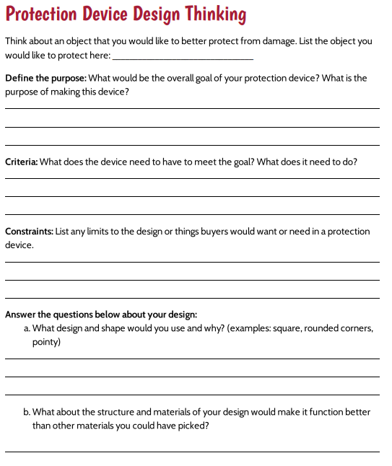
Design Considerations
Slide F
Notes:
Select an object to protect. Project slide F. Distribute Protection Device Design Thinking.
Say, It sounds like you all have great ideas. Let’s see if we can draft some of these ideas on paper and think about how we can better protect our objects.
Instruct students to write their name on the handout. Look at the first line with the students. Ask students to pick one object from the Objects that need (better) protection during a collision chart or choose an object that they would personally like to protect. Have students write this object down on the first line.
Look at the next part with students: “Define the purpose”. Ask students to consider what the overall purpose of a protective device would be for an object. Give students time to write down the purpose of this protective device.
Develop criteria and constraints for students’ chosen object. Say, As we work through developing a device that can better protect our objects, we have to think about what would make this protection device function better than any existing designs. We have to think about what we would need to do to meet the overall purpose of the design and any limits or additional considerations that stakeholders may want or need. Let’s use the next three sections to help us determine our criteria and constraints.
Make connections to the Building A Better Phone Case chart. Read over the last three sections with students. Point out that this is comparable to the ideas that we developed on our Building a Better Phone Case chart. Point out for students the ”Criteria” and ”Constraints” rows on the chart. Some students may point out that the overall goals or criteria are similar, if not the same, to the protection device they are wanting to design. If students make this observation, use this observation to navigate to the next section. If students do not make this observation, ask students if there are any similarities between the two lists and allow students to give 2-3 goals or criteria that are similar or the same.
Compare the chart with student handout answers. As students are thinking about their object that they would like to protect, have them compare their protection device with the Building a Better Phone Case chart.
Ask students these questions:
Are there any criteria that would apply to your individual design AND to a better phone case?
Are any constraints that also apply to both devices?
Have students consider the criteria and constraints that they will have to keep in mind while they are drafting their designs. Have students record these ideas in the last three sections on their handouts.
Ask 2-3 students to share what object they would like to better protect and what their criteria and constraints would be. Allow students to add to their lists as their classmates share their ideas for criteria and constraints.

Slide 7
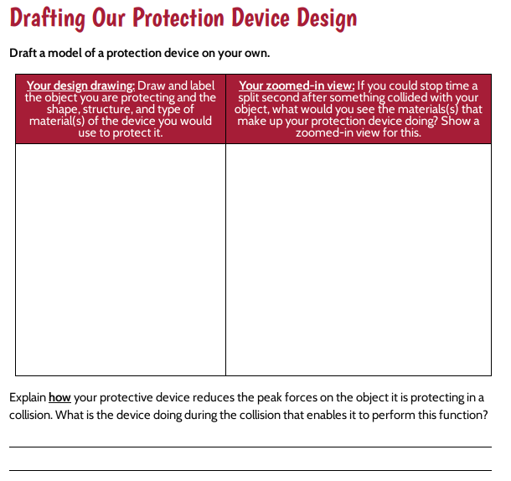
Draft Your Design
Slide G
Notes:
Give students time to draft their initial designs. Project slide G. Pass out Drafting Our Protection Device Design to students. Point out that column 1 is for an overview of their design. Students should draw what their design would look like, what materials they would use, and what shapes would be used in various locations such as corners and sides. Encourage students to use their design thinking from Protection Device Design Thinking to help them design a protective device. Point out that column 2 is space for a zoomed-in view of the main building materials in their device and that students should show what they picture the material(s) that make up their device doing a split second after something collided with it. Challenge students to really try to explain what the device is doing during the collision that enables it to reduce the peak forces on the object it is protecting in a collision.
Give students time to draft their ideas.
Circulate to clarify student thinking. As students are drafting ideas, circulate and ask students the following questions to clarify their thinking and refine their decisions.
What shape are you using for your structure?
What is special about that shape compared to other shapes?
Would another shape work better or worse to help protect your object from damage? Why (or how)?
What constraints did you identify? Do you think your device would meet those constraints? Do you have to consider sizing or type of material?
What criteria did you identify? Can you explain on your handout how your device is able to meet that criteria?
How does your main shape and materials help meet your criteria?
What is special about that material that helps protect against damage?
How does that material react in a collision?
What other materials would function like that material? What made you choose this specific one?
How did you use those other ideas in your device design?
Can you show and explain what sets your device apart from the other devices?

Slide 8

Slide H
Peer Feedback
With a Partner
Feedback Questions
What do you like about the design?
What changes would make it “better” at protecting the object?
What other changes would you make for this design to be more appealing to a stakeholder?
Each person will have 4 minutes to explain their design and receive feedback.
Partner #1 will explain their device to partner #2.
Partner #2 will then give feedback to partner #1 until the timer goes off.
Notes:
Introduce a design feedback task and provide feedback. Project slide H. Explain that in order to make a better protection device, it can’t be just what the designer of the device wants. It should meet the needs of many people who might want to use and buy it. Because of that, it is important to get feedback from others. Tell students that you will set a timer for 4 minutes. One student will explain their design to a partner, then their partner will have until the end of the 4 minutes to give feedback. When the 4-minute period has ended, the partners will shift roles. In the second 4-minute period the second person will explain their design and their partner will give feedback.
Instruct students to look at the questions on the slide. Read the feedback questions with students. Tell students to answer these questions as they give feedback to their partners.
What do you like about the design?
What changes would make it “better” at protecting the object?
What other changes would you make for the device to be more appealing to stakeholders?
Allow students a total of 8 minutes to give and receive feedback with their partners, reminding students to shift roles after the first 4-minute timer goes off.

Slide 9

Home Learning
Slide I
Continued Design Feedback
Ask your family, friends, or community for feedback on your design.
Make any changes to your design you feel are necessary.
Be ready to share with a partner the feedback you received and what changes you made.
Next class we will do a gallery walk to check out each other’s designs!
Notes:
Introduce home learning feedback task. Project slide I. Say, We have received a lot of feedback on our designs! Tonight for home learning, see what your family and others think of your design. Take home your design tonight and revise it based on the feedback they give you.
Have students ask others to give them feedback on their designs and list any other considerations family or others might want students to consider. Encourage students to write any feedback and considerations down in the margins or on the back of Drafting Our Protection Device Design. Tell them to be ready to share their feedback and ideas in the next class meeting and that they will be doing a gallery walk with their designs.

Slide 10

Home Learning Connection
Slide J
Design Feedback
Get out your design ideas from last time.
Turn to a partner and tell them what feedback you received from family and friends.
Look back at your designs. Put a checkmark (✓) or star next to any design changes you made after you left last class.
Notes:
Share home learning feedback. Project slide J. Have students get out their design ideas from the last class. Ask students to think about their home learning. Have students turn to a partner and share the feedback they received. If students did not receive feedback on their designs, have them consider their partner’s feedback for their design and make any modifications they think are needed.
Bring students back together and ask students to place a checkmark or a star next to any changes they have made due to feedback from others.
Say, How many of you feel that feedback from others helped make your initial design for a protective device better? Raise your hand if you received helpful feedback from someone else for your design.
As several students raise their hand, say, Great! It looks like we have gained some good ideas and feedback from others for our personal protective devices. It seems like the more specific the feedback, the better our modifications are. Let’s take some time today and really focus on our feedback to make sure our designs are meeting the goals we identified.

Slide 11

Slide K
Peer Feedback
Gallery Walk
Feedback Questions
What changes would make it “better” at protecting the object?
What other changes would you make about the way it looks, the material, or the shape that would make you (or others) more likely to want to use it more?
What parts do you think will function well?
Give feedback on at least
3 different designs. Leave only 1 sticky note per design.
Use all 3 feedback questions during your feedback process.
If you come to a design with 3 sticky notes already on it, move on until all designs have at least 3 sticky notes.
Notes:
Introduce gallery walk questions. Project slide K. Tell students that in a moment we will have a gallery walk to give feedback on each other’s designs. Explain that good feedback is specific and actionable, meaning that the feedback can be used to make something better, so they will be giving feedback over 3 important design questions. Go over feedback prompts with students.
What changes would make it “better” at protecting the object?
What other changes would you make about the way it looks, the material, or the shape that would make you (or others) more likely to want to use it more?
What parts do you think will function well?
Present feedback structure. Tell students that they should give feedback on 3 different designs and use all 3 prompts during their feedback time. Students can give more than 3 pieces of feedback if they wish, but they should provide feedback on 3 different designs before coming back around to give more feedback. If they come to a design that has 3 sticky notes on it, they should try to find another design that has fewer than 3 sticky notes and leave feedback. No person can give more than one sticky note to a single design.
Provide time for a gallery walk. Arrange the design drafts for easy student access and viewing. Pass out at least 3 sticky notes to each student. Provide 6 minutes for students to give feedback on designs. At the end of the 6 minutes, have students return to their seats with their designs and read over their feedback.

Slide 12
Comparing and Contrasting
Slide L
Comparing Feedback
Compare feedback with your partner.
What do your feedback and designs seem to have in common?
Do your designs have similar criteria and constraints? If so, what are they?
Do you have any feedback that is not similar to your partner’s feedback?
Notes:
Compare feedback. Project slide L. Instruct students to work with a partner to identify commonalities in their feedback. Students will use the following prompts to guide their conversations.
What do your feedback and designs seem to have in common?
Do your designs have similar criteria and constraints? If so, what are they?
Do you have any feedback that is not similar to your partner’s feedback?

Slide 13
Criteria and Constraints
Slide M
Turn and Talk
Whole-Class
Criteria and Constraints
Criteria
Constraints
If we were to make a criteria and constraints list that would work for all our designs, what would be on the list?
Be prepared to share your ideas with the whole class.
Notes:
Lead a criteria and constraints whole-class discussion. Project slide M. Bring students together and have them consider the criteria and constraints.
Say, Do we have a shared goal for all of our devices? Students will identify that we all have the same shared goal of object protection.
Say, Interesting. I wonder if we were to look at our criteria and constraints if they would also be similar across all protection devices. Let’s see if we all seem to have common needs, limits, and considerations.
Have students turn and talk about the following question:
If we were to make a criteria and constraints list that would work for all our designs, what would be on the list?
Record class criteria and constraints. Display the Whole-class Criteria and Constraints T-chart. Use the same prompt from above to engage in a discussion about criteria and constraints that would be shared across designs. Start by pointing to the ”Criteria” side first and asking students if they have a criterion that everyone might have on their designs. Students can reference Protection Device Design Thinking or Drafting Our Protection Device Design to look for criteria that others might also have listed or utilized. Repeat the same thing for constraints. Listen for these ideas and document them on the chart paper:
Criteria
shapes that help to minimize damage (or prevent it completely)
material(s) that helps to minimize damage (or prevent it completely)
Constraints
time to build device
money to build device
availability of materials
size
limits to what we can actually construct as students
looks good
easy to use
low cost to make
good for the environment
can be used more than once (reusable)
If multiple students feel an idea is important, place a star next to the idea or place tallies next to the idea to represent the number of students with that idea. An example of a completed chart using tally marks is shown in the teacher guide.
Discuss commonalities in charts. Instruct students to look at the Building a Better Phone Case chart and compare it to the Whole-class Criteria and Constraints chart that was just created. Ask students to share the similarities and differences of the charts. The criteria and purpose should be the same, and the constraints will have expanded sections on the new chart. Reiterate to students that the criteria are based upon the overall goals or purpose of the design, so it makes sense that the criteria are the same for all the different devices since they are serving the same purpose for a variety of objects.
Say, We have a great list of criteria and constraints that we all agree would be helpful in designing our devices. But, this has me thinking about a lot of questions related to how we will design the best device we can to limit damage. What new questions does this raise for you about the materials, design, structure, and function of these devices? Let’s write our questions down with possible ways to investigate them.

Slide 14

Ideas for Investigation
Slide N
Developing an Action Plan
What we need to figure out
How we can investigate this
Look back at
the class-created charts
your design handouts
your design feedback
What questions do you now have about the materials, design, structure, and function of these protection devices?
Record at least 2 questions on separate sticky notes.
Write at least 1 idea for investigation on a separate sticky note.
Notes:
Document questions and ideas for investigation. Project slide N. Arrange students in a Scientists Circle around a piece of chart paper. Pass out sticky notes to students. Ask students to look back at the class-created charts, their handouts, others’ designs, and any feedback they received from others. Have students consider what questions they now have about the materials, design, structure, and function of the protection devices. Students will record on sticky notes at least 2 questions about materials, design, structure or function and record on at least 1 sticky note an idea for investigation. While students are recording their questions and ideas for investigation, set up a new T-chart on chart paper with the left side titled “What we need to figure out” and the right side “How we can investigate this.”

Slide 15

Slide O
Sharing Questions and Ideas for Investigation
Let’s share our questions and ideas for investigations.
One by one, we will go around and share one question and one idea for investigation.
As the first person reads their question and idea for investigation, give a thumbs up if you wrote down the same question or idea for investigation.
The person reading the question and the idea will collect the sticky notes with the same question and the same idea for investigation from people with their thumbs up and will layer them on top of each other.
The reader will then post them on our T-chart in the appropriate column.
After this, the next person in the circle will read a question and an idea for investigation until all relevant questions and ideas are on the board.
Notes:
Share questions and ideas for investigation. Project slide O. Review with students the expectations for sharing questions and ideas for investigation.
One by one, we will go around and share one question and one idea for investigation.
As the first person reads a question and an idea for investigation, give a thumbs up if you wrote down the same question or the same idea for investigation.
The person reading the question and the idea will collect the sticky notes with the same question and the same idea for investigation from people with their thumbs up and will layer them on top of each other.
The reader will then post them on our T-chart in the appropriate column.
After this, the next person in the circle will read a question and an idea for investigation until all relevant questions and ideas are on the board.
Go around the circle and let students each read one question and one idea for investigation. Continue this until all questions and ideas are presented on the T-chart.

Slide 16
Next Steps
Slide P
Whole-Class Discussion
If we are going to design a protection device, what is something that we all need to investigate to help us build a better device?
Notes:
Motivate the need for material testing. Say, We have a lot of questions and ideas for investigations, and a lot of them seem to deal with our shared list of criteria and constraints.
Project slide P. Ask students to turn and talk about the following question:
If we are going to design a protection device, what is something that we all need to investigate to help us build a better device?
Elicit student responses. Use the prompts and responses found in the teacher guide to guide navigation to the next lesson. It is OK if this discussion is continued at the beginning of Lesson 12 if time is short.
Say, As you leave class, start thinking about what we’ve done in the past and the equipment that we’ve used that we can repurpose to test different materials in a collision to see how they affect the peak forces in a collision. Getting some results for that next time will help us make informed decisions about one important criteria for determining which material types would work better for our designs.
If desired, collect Drafting Our Protection Device Design as a pre-assessment of ideas developed in Lessons 12-15. Make copies of the handout and use the copies to compare to the student's individual models at the end of this lesson set. Return Drafting Our Protection Device Design to students at the beginning of Lesson 12.

